Slide 1
Data Exploration
Programming for Data Analysis (CT127-3-2-PFDA and Version VC1)

Slide 2
Topic & Structure of the lesson
Data Exploration
Variation
Covariation
Missing values

Slide 3
Learning outcomes
At the end of this topic, you should be able to:
Understand how to use data visualization as a tool for data exploration.

Slide 4
Key terms you must be able to use
If you have mastered this topic, you should be able to use the following terms correctly in your assignments and exams:
Data exploration
Variation
Covariation
Missing values

Slide 5
Data Exploration
Data exploration is the first step in data analysis, and it is utilized to examine the data to create a broad picture of important points to study them in more details.
Data visualization can be used for data exploration to help in understanding and summarizing the data.

Slide 6
Variation
Variation is the tendency of the values of a variable to change from measurement to measurement.
Every variable has its own pattern of variation, which can reveal interesting information. The best way to understand that pattern is to visualize the distribution of the variable’s values.
To examine the distribution of a categorical variable, use a bar chart, while use histogram for a continuous variable.
In both bar charts and histograms, tall bars show the common values of a variable, and shorter bars show less-common values.

Slide 7
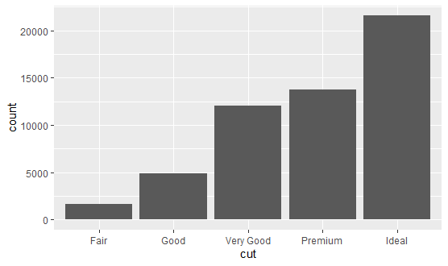
Variation
Examine the distribution of a categorical variable:
ggplot(data = diamonds) + geom_bar(mapping = aes(x = cut))

Slide 8
Interpret the key results for Bar chart
Differences in the heights of the bars.

Slide 9
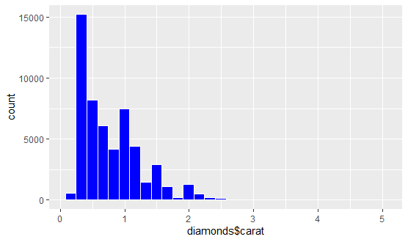
Variation
Examine the distribution of a continuous variable:
ggplot(data=diamonds) +
geom_histogram(aes(diamonds$carat),col="white", fill="blue")

Slide 10
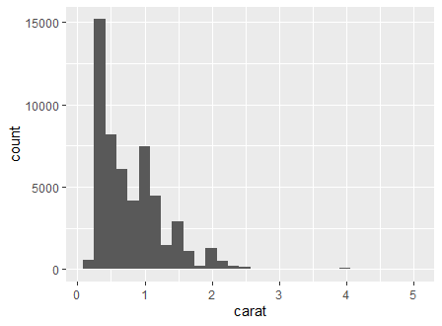
Interpret the key results for Histogram
Peaks and spread
Symmetry of the data
Multiple modes
Outliers

Slide 11
Covariation
Covariation is the tendency for the values of two or more variables to vary together in a related way.
The best way to spot covariation is to visualize the relationship between two or more variables.

Slide 12
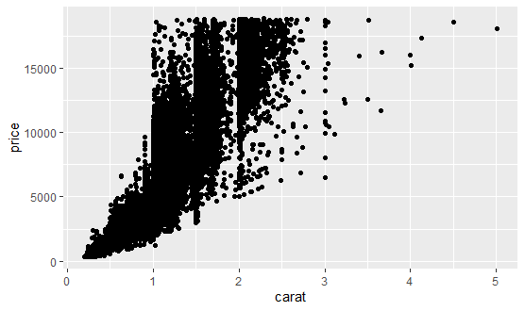
Covariation
Two continuous variables: can be explored using scatter plots.
ggplot(data = diamonds) + geom_point(mapping = aes(x = carat, y = price))

Slide 13
Interpret the key results for Scatterplot
Type of relationship.
Strength of relationship.
Outliers.

Slide 14
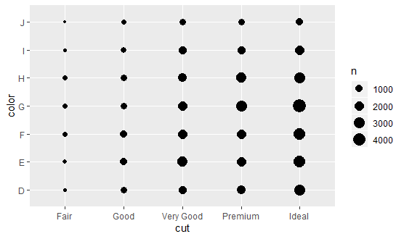
Covariation
Two categorical variables: can be explored by counting the number of observations for each combination.
ggplot(data = diamonds) + geom_count(mapping = aes(x = cut, y = color))
N represents how many observations occurred at each combination of values. Covariation will appear as a strong correlation between specific x values and specific y values.

Slide 15
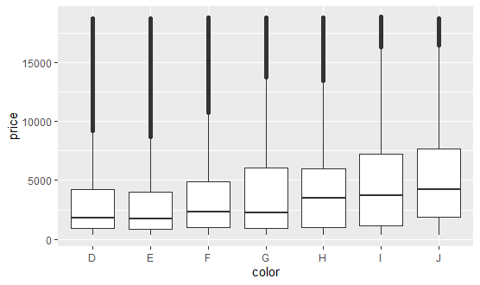
Covariation
A categorical and continuous variables: can be explored using boxplots.
ggplot(data = diamonds, mapping = aes(x = color, y = price)) + geom_boxplot()

Slide 16
Interpret the key results for Boxplots
Centers and Spreads
Symmetry of the data
Outliers

Slide 17
Missing values
A missing value occurs when no data value is found for a variable in an observation.
If there are unusual values in the dataset, then you have two options:
Drop the entire row with the strange values.
Replacing the unusual values with missing values.
Some functions in R has an argument like na.rm to indicate whether missing values should be stripped before the computation proceeds or not.

Slide 18
Summary of Main Teaching Points
Variation
Covariation
Missing values

Slide 19
References:
https://r4ds.had.co.nz/exploratory-data-analysis.html
https://support.minitab.com/en-us/minitab-express/1/help-and-how-to/graphs/bar-chart/interpret-the-results/interpret-the-results/
https://support.minitab.com/en-us/minitab-express/1/help-and-how-to/graphs/histogram/interpret-the-results/key-results/
https://support.minitab.com/en-us/minitab-express/1/help-and-how-to/graphs/scatterplot/interpret-the-results/key-results/
https://www.youtube.com/watch?time_continue=203&v=PE_BpXTyKCE&feature=emb_logo
https://support.minitab.com/en-us/minitab-express/1/help-and-how-to/graphs/boxplot/interpret-the-results/key-results/

Slide 20
Q & A

Slide 21
Next Session
Data Manipulation and Transformation

